Slide 1
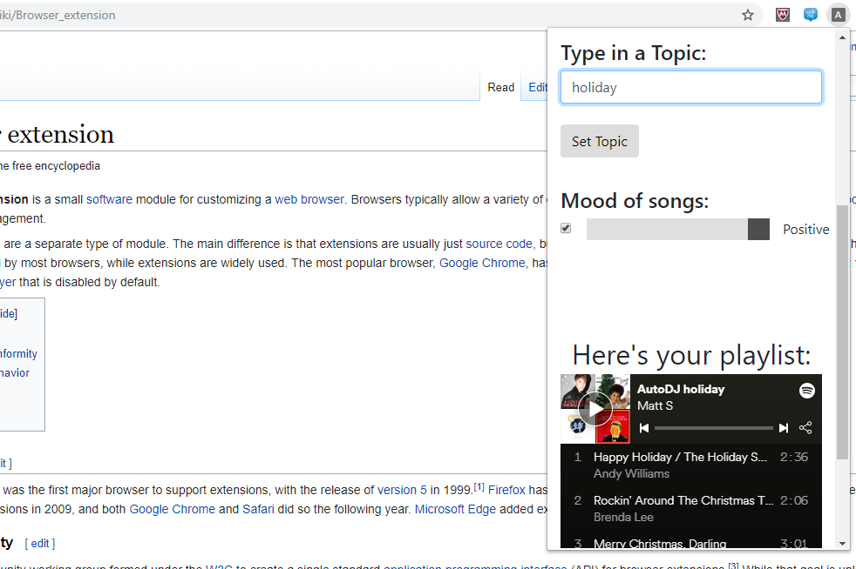

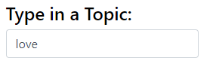

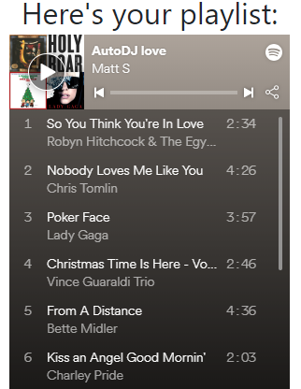
Auto DJ Playlist Generator
Craig Dunton, Nick Bova, Steven Sun, Matthew Stock
–
THE OHIO STATE UNIVERSITY / COLLEGE OF ENGINEERING / COMPUTER SCIENCE AND ENGINEERING
INTRODUCTION
AutoDJ is a playlist creation tool which helps users find the music that they want to listen to. AutoDJ dynamically creates song playlists by using IBM Watson Discovery to query a database for music concepts and themes. AutoDJ also integrates with Spotify’s API to automatically post playlists to a user’s account, and allows users to play music using the Spotify web player.
DESIGN
Technologies
Spotify API
IBM Watson Discovery
Python Flask
JavaScript Jquery Requests
Travis Continuous Integration
Pytest Testing Framework
INTERACTION
Users can specify a topic or concept that will be used to query the Watson Discovery backend. Also, users can specify a mood as another query parameter, allowing them to tailor the results to their liking. After a user submits their constructed query they are prompted to wait for the Spotify response. Finally, the user is returned a preview of their resulting query and confirmation that the playlist was added to their account.
AutoDJ Browser Extension
Another way users can interact with AutoDJ is through the browser extension version of the application. This extension ports the functionality of the webpage to a Chrome browser extension, allowing users to create playlists on the fly regardless of what webpage they are on.
AutoDJ Logo
Example AutoDJ Query
Example Playlist Created
AutoDJ Browsing Player
Another feature that AutoDJ provides is an automatic music player which is integrated into the chrome extension. This player pulls information from the webpage a user is currently browsing and plays music appropriate to the concepts and theme of the webpage.
A user navigates to the Wikipedia page for happiness and AutoDJ begins playing the song Happy by Will Pharrell.
A user navigates to the Wikipedia page for stars and AutoDJ plays Drops of Jupiter by Train.
Front End
AutoDJ supplies a webpage interface as well as a Google Chrome extension which provide the same playlist creating functionality. Both of these methods are implemented using JavaScript web queries and CSS backed HTML.
Back End
The webpage and extension are both connected to external services using a Python Flask server backend. This server handles web REST API requests on behalf of the user to streamline the playlist creation and saving process. In addition to saving the playlist to the user’s Spotify account, the server also posts the playlist back to the webpage or extension to allow the user to preview their playlist.
FUTURE WORK
Larger database for more relevant query results.
More tuning parameters to tailor results for users.
Removal of duplicate, or similar results.
Integration into other music provider platforms.
Caching for common queries.
Miscellaneous performance improvements.
WEBSITE / URL

